Slide 1
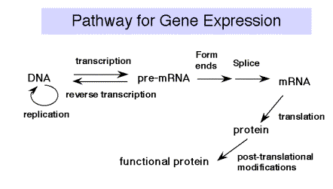
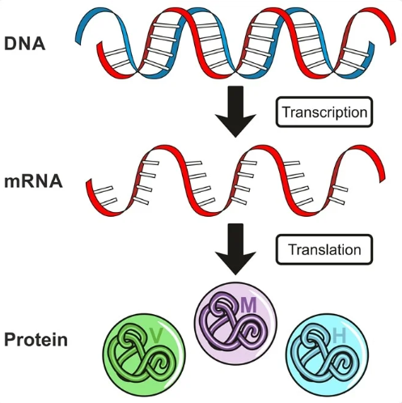
Gene Expression
Part 3
Transcription
Translation

Slide 2
1 Transcription & RNA Processing
1.1 Molecular Structure of RNA
1.2 Nucleic Acids
1.3 Transcription and mRNA Processing
1.4 Post-transcriptional regulation
1.5 Eukaryotic Gene transcription (Going from DNA to mRNA)
1.6 Transcription
1.7 Eukaryotic pre-mRNA Processing

Slide 3
1.1 & 1.2 Molecular Structure of RNA
In 2’ of ribose there is OH (hydroxyl) group is present then it tells ribose means RNA
Nitrogenous Bases are A U G C
In uracil CH-3 (methyl) group is present
When compared with other bases Uracil is less stable

Slide 4
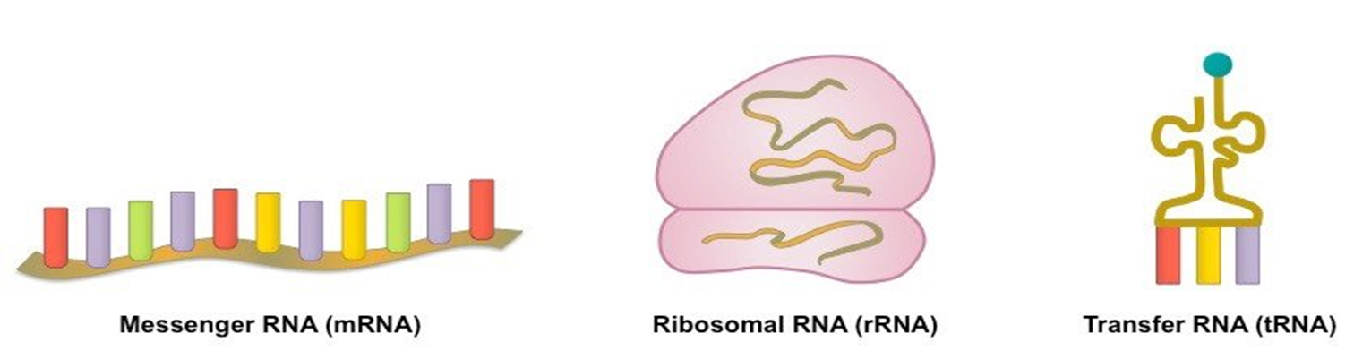
Types of RNA
In both Pro and Eukaryotes 3 main classes of RNA molecules exist:
Messenger RNA(mRNA)
Transfer RNA(tRNA)
Ribosomal RNA(rRNA)

Slide 5
1. Messenger RNA (mRNA):
Only a few percent of total cellular RNA is mRNA (only about 5%).
It is a linear, single-stranded molecule with 5’ and 3’ ends.
It shows large variations or heterogeneity in its length and nucleotide composition.
mRNAs contain genetic information for protein synthesis in the form of three-nucleotide codons, which each one specifies amino acid.
Since the message of protein is contained in the codons of mRNA, it is called messenger RNA (mRNA).
This genetic information is interpreted to generate the linear sequences of amino acids in a polypeptide chain or proteins.
The protein-coding region(s) of each mRNA is composed of a contiguous, non-overlapping string of codons called an open reading frame (ORF).
Each ORF specifies a single protein and starts and ends at internal sites within the mRNA. i.e. the ends of an ORF are distinct from the ends of the mRNA.
Translation starts at the 5’end of the ORF and proceeds one codon at a time to the 3’ end. The first and the last codons of an ORF are known as the start and stop codons.
Eukaryotic cells always use 5’-AUG-3’ as the start codon whereas in bacteria, the start codon is usually 5’-AUG-3’ but 5’-GUG-3’ and sometimes even 5’-UUG-3’ are also used.

Slide 6
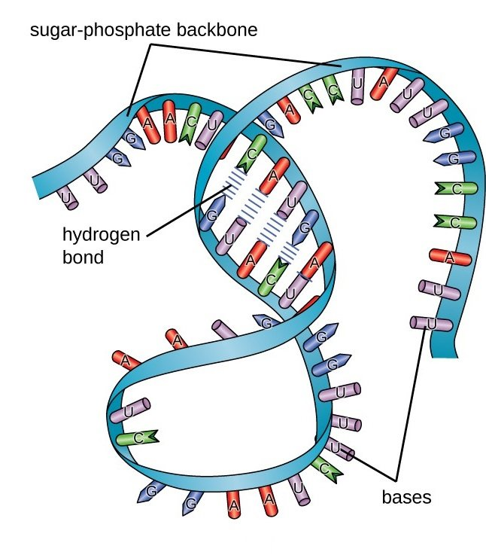
RNA Secondary Structure
Most RNA molecules are single-stranded but an RNA molecule may contain regions which can form complementary base pairing where the RNA strand loops back on itself.
If so, the RNA will have some double-stranded regions.
Ribosomal RNAs (rRNAs) and transfer RNAs (tRNAs) exhibit substantial secondary structure, as do some messenger RNAs (mRNAs).

Slide 7
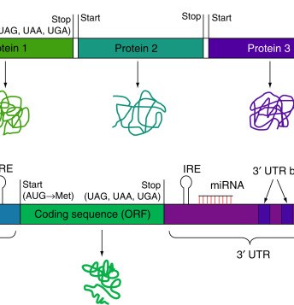
mRNA
The start codon has two important functions;
First, it specifies the first amino acid to be incorporated into the growing polypeptide chain.
Second, it defines the for all subsequent codons. reading frame
Stop codons like 5’-UAG-3’, 5’- UGA-3’ and 5’-UAA-3’, define the end of the ORF and signal termination of polypeptide synthesis.
The number of ORFs per mRNA is different between prokaryotes and eukaryotes.

Slide 8
mRNA
Eukaryotic mRNAs almost always contain a single ORF and hence code for a single polypeptide chain. Such mRNAs are called mono-cistronic mRNAs.
In contrast, prokaryotic mRNAs frequently contain two or more ORFs and hence can code for multiple polypeptide chains. Such mRNAs containing multiple ORFs are called poly-cistronic mRNAs.
In eukaryotic cells, 5’-end of mRNA is capped. The 5’ cap is methylated guanine nucleotide (7-methyl guanosine tri-phosphate) that is joined to the 5’ end of mRNA. Similarly, 3’- end is also modified as it has a poly-A tail. Poly-A tail consists of a large number of Adenine nucleotides.
5’ cap and poly A tail are absent in prokaryotic cells.
5’ cap helps to recognize and bind ribosomes during protein synthesis, whereas poly-A tail enhances the level of translation of the mRNAs by promoting efficient recycling of ribosomes.
To facilitate binding by a ribosome, many prokaryotic ORFs contain a short sequence upstream (on the 5’ side) of the start codon called the ribosome binding site (RBS) also referred to as Shine-Dalgarno sequence.

Slide 9
Functions of mRNA:
mRNA acts as a template during protein synthesis. Therefore, it is also known as template RNA. Each codon of mRNA codes for specific amino acids during protein synthesis.

Slide 10
2. Transfer RNA (tRNA):
It is the smallest type of RNA and accounts for 15% of total RNA in the cell.
Due to its smallest size, it is also called soluble RNA.
Basic structure of tRNA of prokaryotes and eukaryotes is same.
tRNA molecules exhibit a characteristic and highly conserved pattern of single-stranded and double-stranded regions (secondary structure).
It is clover-leaf shaped.
tRNA has four loops where there is no base-pairing whereas in other regions, where bases come closer, they form H-bonds and show a double-stranded structure.
The principal features of the tRNA cloverleaf are an acceptor stem, three stem loops (referred to as the pseudouridine loop, the D loop and the anticodon loop) and a fourth variable loop.

Slide 11
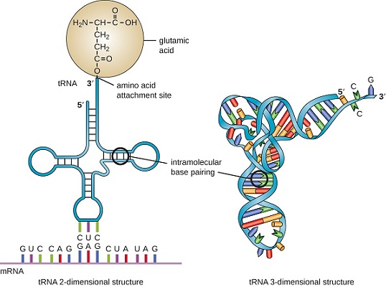
Str’e of tRNA
The acceptor stem is the site of attachment of amino acid that is formed by pairing between the 5’ and 3’ ends of the tRNA molecule. The 5’-CCA-3’ sequence at the extreme 3’ end of the molecule is a single-stranded region that protrudes from this double-stranded stem.
The pseudo-uridine loop is so named because of the characteristic presence of the unusual base pseudo-uridine (ΨU) in the loop. The modified base is often found within the sequence 5’-T ΨUCG-3’.
The D loop takes its name from the characteristic presence of dihydrouriidines in the loop.
The anticodon loop, as its name implies, contains the anticodon, a three-nucleotide- long sequence that is responsible for recognizing the codon by base pairing with the mRNA. The anticodon is always bracketed on the 3’ end by a purine and on its 5’ end by uracil.
The variable loop sits between the anticodon loop and the ΨU loop and, as its name implies, varies in size from 3 to 21 bases.
Besides these loops, there are two terminals; 3’-ACC end (which binds amino acid) and a phosphorylated 5’ end.

Slide 12
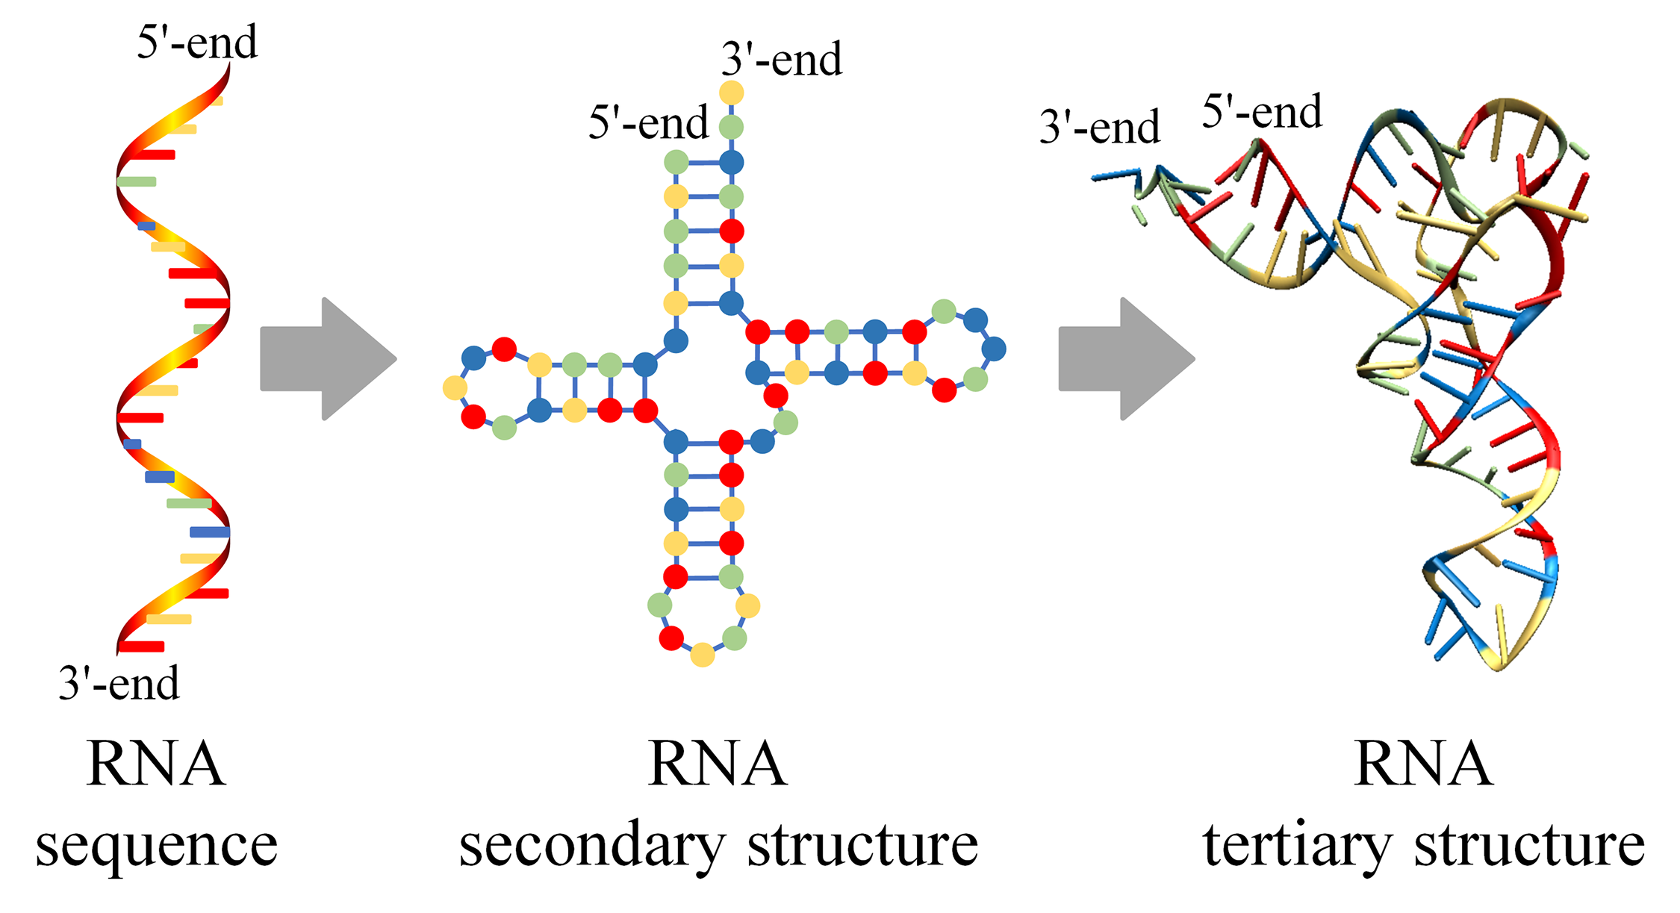
tRNA

Slide 13
Functions of tRNA:
During the process of protein synthesis, charged tRNA transfers activated amino acids into growing polypeptide chain.
tRNA molecules to which an amino acid is attached are said to be charged and such amino acids attached to a tRNA are called activated amino acids.
Amino acyl-tRNA synthetases charge tRNAs. Anticodon in tRNA recognizes the codon in mRNA for a specific amino acid. tRNAs are charged by the attachment of that specific amino acid to the 3’- terminal Adenosine nucleotide via high-energy acyl linkage and later on incorporated into a growing polypeptide chain.

Slide 14
3. Ribosomal RNA (rRNA):
rRNA is the heaviest RNA having high molecular weight (> 1000 KD) and accounts for 80% of the total RNA in a cell.
It exists in a secondary structure in which single strand coils and folds up on itself, however, the overall structure of rRNA differs from one another.
rRNAs are the structural components of the ribosomes, hence called ribosomal RNA. They are directly responsible for the key functions of the ribosome.
The ribosome is composed of two subassemblies of RNA and protein known as the large and small subunits.
The large subunit contains the peptidyl transferase center, which is responsible for the formation of peptide bonds. The small subunit contains the decoding centre in which charged tRNAs read or ‘decode’ the codon units of the mRNA.

Slide 15
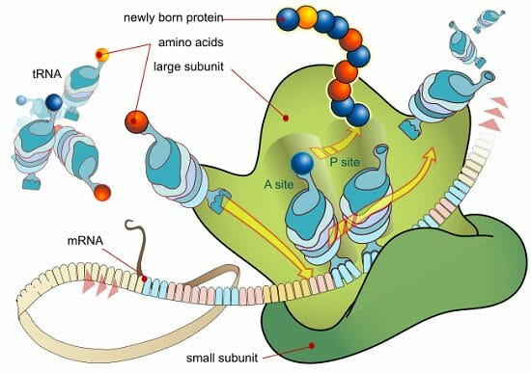
Str’e of rRNA
In prokaryotes, 50S and 30S ribosomal subunits unite to form a single intact ribosome of 70S. More than two-thirds of the mass of the prokaryotic ribosomes is RNA. In bacteria, the 50S subunit contains a 5S rRNA and a 23S rRNA, whereas, the 30S subunit contains a single 16S rRNA.
The eukaryotic ribosome is somewhat larger, composed of 60S and 40S subunits, which together form an 80S ribosome. 40S subunit contains an 18S rRNA whereas, 60S subunit contains a 5S rRNA, 28S rRNA and a 5.8S rRNA (in mammals only).
The large and small subunits are each composed or one or more rRNAs. 16S and 23S rRNAs are large. On average, a single nucleotide has a molecular mass of 330D; therefore, on its own, the 2900-nucleotide long 23S rRNA has a molecular weight of almost 1000 KD.
rRNA has a distinctive three-dimensional shape which is made up of internal loops and helices that creates specific sites, A, P, and E, within the ribosome.

Slide 16
Functions of rRNA:
rRNA provides specific sequence to which an mRNA can bind during the process of protein synthesis. The anticodon loops of the charged tRNAs and the codons of the mRNAs contact the 16S rRNA, not the ribosomal proteins of the smaller subunit during translation.
It plays a structural role, as in the case of the RNA components of the ribosomal subunits.
It also acts as enzyme that catalyzes essential reactions in the cell. Such RNAs are also called ribozymes. Hence rRNAs are both structural and catalytic determinants of the ribosome.

Slide 17
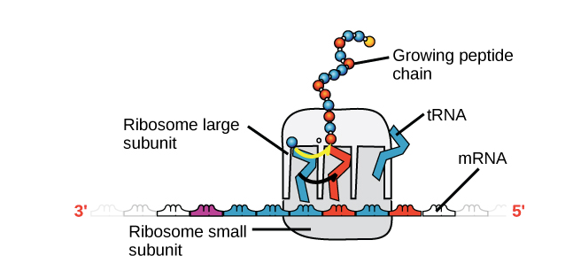
Difference between mRNA, tRNA , and rRNA
mRNA | rRNA | tRNA
Once an mRNA has been produced, it will associate with a ribosome, a molecular machine that specializes in assembling proteins out of amino acids. The ribosome uses the information in the mRNA to make a protein of a specific sequence, “reading out” the mRNA’s nucleotides in groups of three (called codons) and adding a particular amino acid for each codon. | Ribosomal RNA (rRNA) is a major component of ribosomes, where it helps mRNA bind in the right spot so its sequence information can be read out. Some rRNAs also act as enzymes, meaning that they help accelerate (catalyze) chemical reactions – in this case, the formation of bonds that link amino acids to form a protein. RNAs that act as enzymes are known as ribozymes. | Transfer RNAs (tRNAs) are also involved in protein synthesis, but their job is to act as carriers – to bring amino acids to the ribosome, ensuring that the amino acid added to the chain is the one specified by the mRNA. Transfer RNAs consist of a single strand of RNA, but this strand has complementary segments that stick together to make double-stranded regions. This base-pairing creates a complex 3D structure important to the function of the molecule.

Slide 18
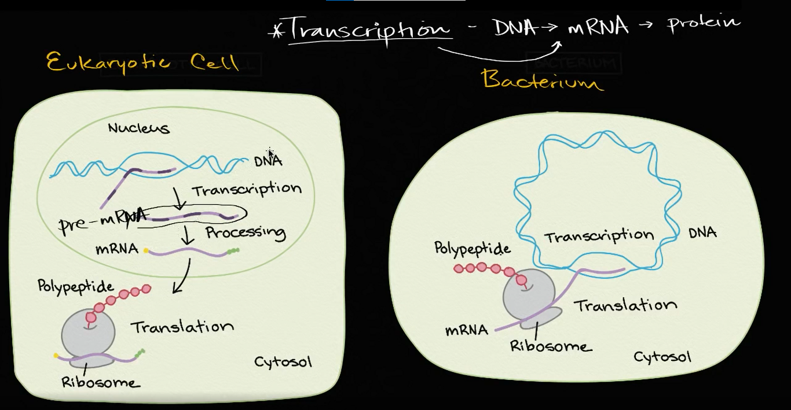
1.3 Transcription and mRNA Processing

Slide 19
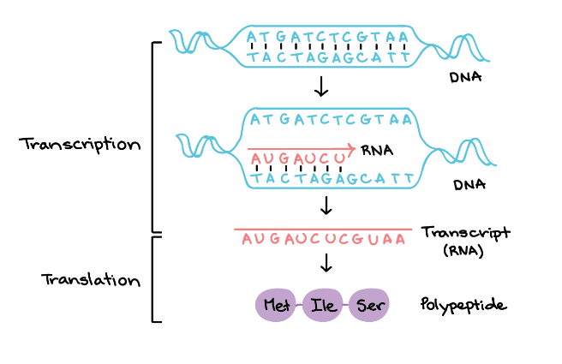
Overview of transcription
Transcription is the first step in gene expression, in which information from a gene is used to construct a functional product such as a protein. The goal of transcription is to make an RNA copy of a gene's DNA sequence. For a protein-coding gene, the RNA copy, or transcript, carries the information needed to build a polypeptide (protein or protein subunit).
Eukaryotic transcripts need to go through some processing steps before translation into proteins.

Slide 20
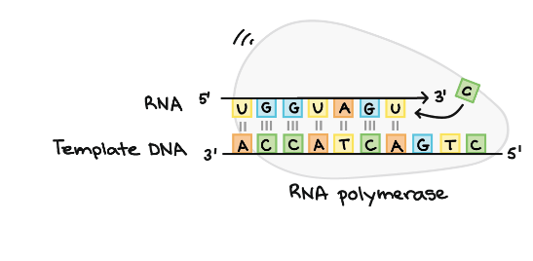
RNA polymerase
The main enzyme involved in transcription is RNA polymerase, which uses a single-stranded DNA template to synthesize a complementary strand of RNA. Specifically, RNA polymerase builds an RNA strand in the 5' to 3' direction, adding each new nucleotide to the 3' end of the strand.

Slide 21
Stages of transcription
Transcription of a gene takes place in three stages:
1. initiation,
2. elongation, and
3. Termination
Here, we will briefly see how these steps happen in bacteria(Prokaryotes)

Slide 22
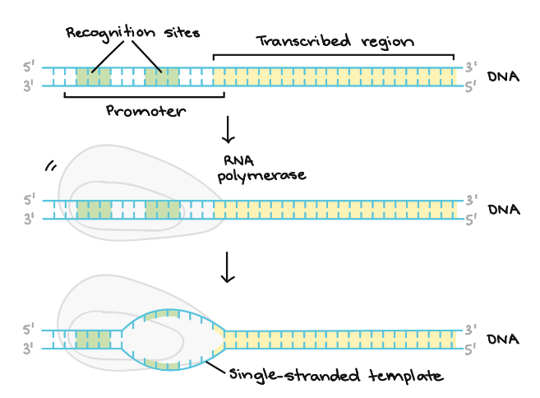
1. Initiation.
RNA polymerase binds to a sequence of DNA called the promoter, found near the beginning of a gene. Each gene (or group of co-transcribed genes, in bacteria) has its own promoter. Once bound, RNA polymerase separates the DNA strands, providing the single-stranded template needed for transcription.

Slide 23
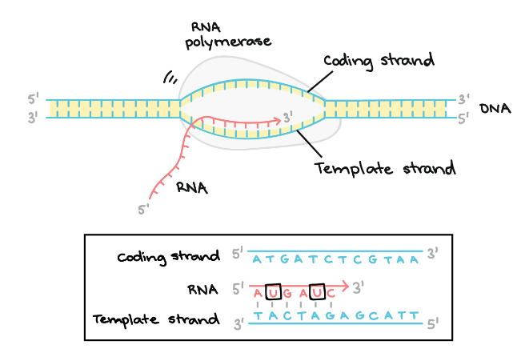
2. Elongation
One strand of DNA, the template strand, acts as a template for RNA polymerase. As it "reads" this template one base at a time, the polymerase builds an RNA molecule out of complementary nucleotides, making a chain that grows from 5' to 3'. The RNA transcript carries the same information as the non-template (coding) strand of DNA, but it contains the base uracil (U) instead of thymine (T).

Slide 24
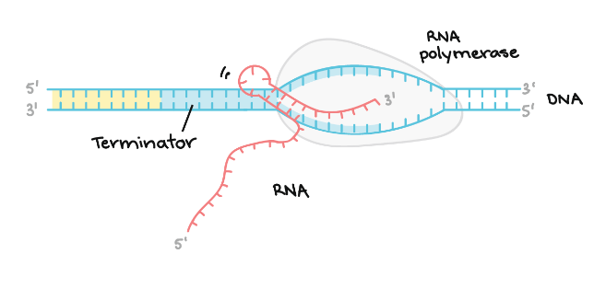
3. Termination
Sequences called terminators signal that the RNA transcript is complete. Once they are transcribed, they cause the transcript to be released from the RNA polymerase.
An example of a termination mechanism involving the formation of a hairpin in the RNA is shown below.

Slide 25
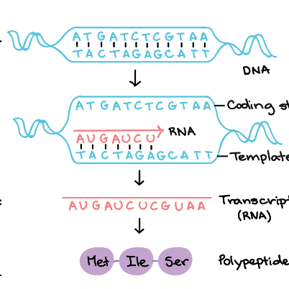
Here, we will briefly see how these Transcription steps happen in Eukaryotes & Prokaryotes
Transcription overview
Transcription is the first step of gene expression. During this process, the DNA sequence of a gene is copied into RNA.
Before transcription can take place, the DNA double helix must unwind near the gene that is getting transcribed. The region of opened-up DNA is called a transcription bubble.

Slide 26
Cont.
The site on the DNA from which the first RNA nucleotide is transcribed is called the +1 site, or the initiation site. Nucleotides that come before the initiation site are given negative numbers and said to be upstream. Nucleotides that come after the initiation site are marked with positive numbers and said to be downstream.
If the gene that's transcribed encodes a protein (which many genes do), the RNA molecule will be read to make a protein in a process called translation.

Slide 27
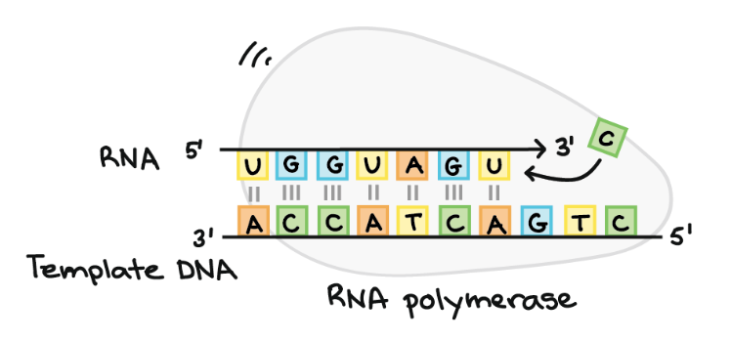
RNA polymerase
RNA polymerases are enzymes that transcribe DNA into RNA. Using a DNA template, RNA polymerase builds a new RNA molecule through base pairing. For instance, if there is a G in the DNA template, RNA polymerase will add a C to the new, growing RNA strand.
RNA polymerase always builds a new RNA strand in the 5’ to 3’ direction. That is, it can only add RNA nucleotides (A, U, C, or G) to the 3' end of the strand.
RNA polymerases are large enzymes with multiple subunits, even in simple organisms like bacteria. Humans and other eukaryotes have three different kinds of RNA polymerase: I, II, and III. Each one specializes in transcribing certain classes of genes. Plants have an additional two kinds of RNA polymerase, IV and V, which are involved in the synthesis of certain small RNAs.

Slide 28
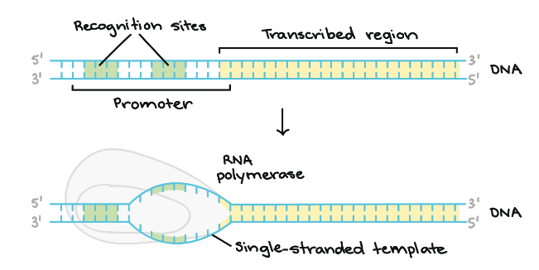
Transcription Initiation
To begin transcribing a gene, RNA polymerase binds to the DNA of the gene at a region called the promoter. Basically, the promoter tells the polymerase where to "sit down" on the DNA and begin transcribing.
Each gene (or, in bacteria, each group of genes transcribed together) has its own promoter. A promoter contains DNA sequences that let RNA polymerase or its helper proteins attach to the DNA. Once the transcription bubble has formed, the polymerase can start transcribing.

Slide 29
Promoters in bacteria
To get a better sense of how a promoter works, let's look an example from bacteria. A typical bacterial promoter contains two important DNA sequences, the -10 and -35 elements.
RNA polymerase recognizes and binds directly to these sequences. The sequences position the polymerase in the right spot to start transcribing a target gene, and they also make sure it's pointing in the right direction.
Once the RNA polymerase has bound, it can open up the DNA and get to work. DNA opening occurs at the -10 element, where the strands are easy to separate due to the many As and Ts (which bind to each other using just two hydrogen bonds, rather than the three hydrogen bonds of Gs and Cs).

Slide 30
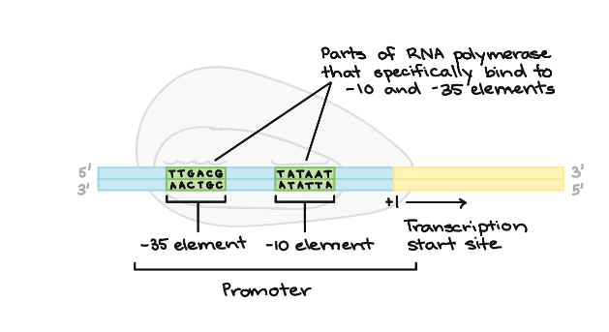
Cont.
The -10 and the -35 elements get their names because they come with 35 and 10 nucleotides before the initiation site (+1 in the DNA). The minus signs just mean that they are before, not after, the initiation site.

Slide 31
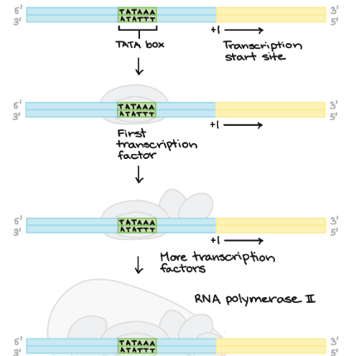
Promoters in humans
In eukaryotes like humans, the main RNA polymerase in your cells does not attach directly to promoters like bacterial RNA polymerase. Instead, helper proteins called basal (general) transcription factors bind to the promoter first, helping the RNA polymerase in your cells get a foothold on the DNA.
Many eukaryotic promoters have a sequence called a TATA box. The TATA box plays a role much like that of the -101010 element in bacteria. It's recognized by one of the general transcription factors, allowing other transcription factors and eventually RNA polymerase to bind. It also contains lots of As and Ts, which make it easy to pull the strands of DNA apart.

Slide 32
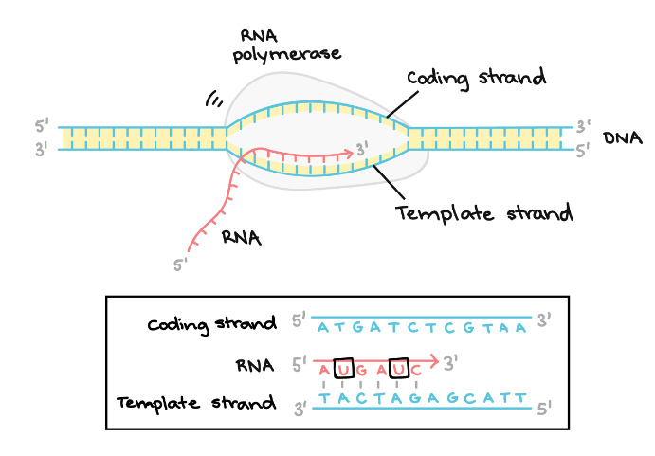
Elongation
Once RNA polymerase is in position at the promoter, the next step of transcription—elongation—can begin. Basically, elongation is the stage when the RNA strand gets longer, thanks to the addition of new nucleotides.
During elongation, RNA polymerase "walks" along one strand of DNA, known as the template strand, in the 3' to 5' direction. For each nucleotide in the template, RNA polymerase adds a matching (complementary) RNA nucleotide to the 3' end of the RNA strand.

Slide 33

Cont.
The RNA transcript is nearly identical to the non-template, or coding, strand of DNA. However, RNA strands have the base uracil (U) in place of thymine (T), as well as a slightly different sugar in the nucleotide. So, as we can see in the diagram above, each T of the coding strand is replaced with a U in the RNA transcript.

Slide 34
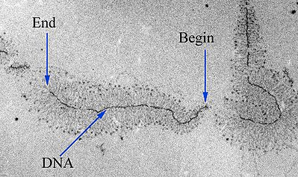
Real copy of DNA
The picture below shows DNA being transcribed by many RNA polymerases at the same time, each with an RNA "tail" trailing behind it. The polymerases near the start of the gene have short RNA tails, which get longer and longer as the polymerase transcribes more of the gene.

Slide 35
Transcription termination
RNA polymerase will keep transcribing until it gets signals to stop. The process of ending transcription is called termination, and it happens once the polymerase transcribes a sequence of DNA known as a terminator.

Slide 36
Termination in bacteria
There are two major termination strategies found in bacteria:
1. Rho-dependent, and
2. Rho-independent.
In Rho-dependent termination, the RNA contains a binding site for a protein called Rho factor. Rho factor binds to this sequence and starts "climbing" up the transcript towards RNA polymerase.

Slide 37
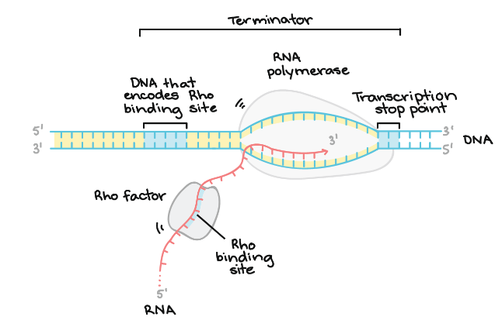
Cont.
When it catches up with the polymerase at the transcription bubble, Rho pulls the RNA transcript and the template DNA strand apart, releasing the RNA molecule and ending transcription. Another sequence found later in the DNA, called the transcription stop point, causes RNA polymerase to pause and thus helps Rho catch up

Slide 38
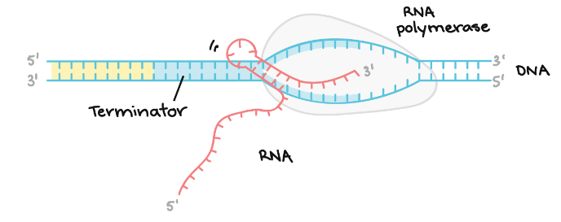
2. Rho-independent termination
Rho-independent termination depends on specific sequences in the DNA template strand. As the RNA polymerase approaches the end of the gene being transcribed, it hits a region rich in C and G nucleotides. The RNA transcribed from this region folds back on itself, and the complementary C and G nucleotides bind together. The result is a stable hairpin that causes the polymerase to stall.
In a terminator, the hairpin is followed by a stretch of U nucleotides in the RNA, which match up with A nucleotides in the template DNA. The complementary U-A region of the RNA transcript forms only a weak interaction with the template DNA. This, coupled with the stalled polymerase, produces enough instability for the enzyme to fall off and liberate the new RNA transcript.

Slide 39
Termination in Eukaryotes
In eukaryotes like humans, transcription termination happens differently depending on the type of gene involved. Here, we'll see how termination works for protein-coding genes.
Note: This is a pretty weird mechanism. It does not make complete sense, even to the biologists who study it in great detail. You have been warned!
Termination begins when a polyadenylation signal appears in the RNA transcript. This is a sequence of nucleotides that marks where an RNA transcript should end. The polyadenylation signal is recognized by an enzyme that cuts the RNA transcript nearby, releasing it from RNA polymerase.
Oddly enough, RNA polymerase continues transcribing after the transcript is released, often making 500 - 2,000 more nucleotides' worth of RNA
Eventually, it detaches from the DNA through mechanisms that are not yet fully understood. The extra RNA is not usually translated and seems to be wasteful by the product of transcription.

Slide 40
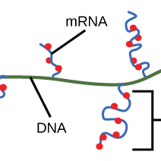
What happens to the RNA transcript?
After termination, transcription is finished. An RNA transcript that is ready to be used in translation is called a messenger RNA (mRNA). In bacteria, RNA transcripts are ready to be translated right after transcription. In fact, they're actually ready a little sooner than that: translation may start while transcription is still going on
In the diagram below, mRNAs are being transcribed from several different genes. Although transcription is still in progress, ribosomes have attached each mRNA and begun to translate it into protein. When an mRNA is being translated by multiple ribosomes, the mRNA and ribosomes together are said to form a polyribosome.

Slide 41
Why can transcription and translation happen simultaneously for an mRNA in bacteria?
One reason is that these processes occur in the same 5' to 3' direction. That means one can follow or "chase" another that's still occurring. Also, in bacteria, there are no internal membrane compartments to separate transcription from translation.
The picture is different in the cells of humans and other eukaryotes. That's because transcription happens in the nucleus of human cells, while translation happens in the cytosol. Also, in eukaryotes, RNA molecules need to go through special processing steps before translation. That means translation can't start until transcription and RNA processing are fully finished

Slide 42
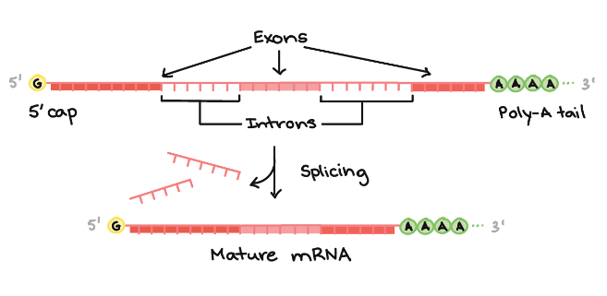
Eukaryotic RNA modifications
In bacteria, RNA transcripts can act as messenger RNAs (mRNAs) right away. In eukaryotes, the transcript of a protein-coding gene is called a pre-mRNA and must go through extra processing before it can direct translation.
Eukaryotic pre-mRNAs must have their ends modified, by addition of a 5' cap (at the beginning) and 3' poly-A tail (at the end).
Many eukaryotic pre-mRNAs undergo splicing. In this process, parts of the pre-mRNA (called introns) are chopped out, and the remaining pieces (called exons) are stuck back together.

Slide 43
Cont.
End modifications increase the stability of the mRNA, while splicing gives the mRNA its correct sequence. (If the introns are not removed, they'll be translated along with the exons, producing a "gibberish" polypeptide.)

Slide 44
Eukaryotic pre-mRNA processing
In bacteria, RNA transcripts are ready to act as messenger RNAs and get translated into proteins right away. In eukaryotes, things are a little more complex, though in a pretty interesting way. The molecule that's directly made by transcription in one of your (eukaryotic) cells is called a pre-mRNA, reflecting that it needs to go through a few more steps to become an actual messenger RNA (mRNA). These are:
Addition of a 5' cap to the beginning of the RNA
Addition of a poly-A tail (tail of A nucleotides) to the end of the RNA
Chopping out of introns, or "junk" sequences, and pasting together of the remaining, good sequences (exons)
Once it's completed these steps, the RNA is a mature mRNA. It can travel out of the nucleus and be used to make a protein.

Slide 45
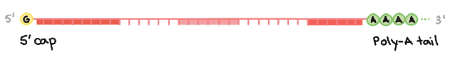
5' cap and poly-A tail
The 5’ cap is added to the first nucleotide in the transcript during transcription. The cap is a modified guanine (G) nucleotide, and it protects the transcript from being broken down. It also helps the ribosome attach to the mRNA and start reading it to make a protein
How is the poly-A tail added?
The 3' end of the RNA forms in kind of a bizarre way. When a sequence called a polyadenylation signal shows up in an RNA molecule during transcription, an enzyme chops the RNA in two at that site. Another enzyme adds about 100 - 200 adenine (A) nucleotides to the cut end, forming a poly-A tail. The tail makes the transcript more stable and helps it get exported from the nucleus to the cytosol

Slide 46
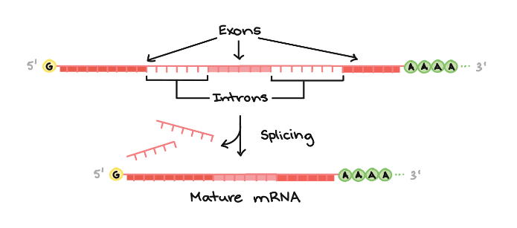
RNA splicing
The third big RNA processing event that happens in your cells is RNA splicing. In RNA splicing, specific parts of the pre-mRNA, called introns are recognized and removed by a protein-and-RNA complex called the spliceosome. Introns can be viewed as "junk" sequences that must be cut out so the "good parts version" of the RNA molecule can be assembled.
What are the "good parts"?
The pieces of the RNA that are not chopped out are called exons. The exons are pasted together by the spliceosome to make the final, mature mRNA that is shipped out of the nucleus.

Slide 47
Cont.
A key point here is that it's only the exons of a gene that encode a protein. Not only do the introns not carry information to build a protein, they actually have to be removed in order for the mRNA to encode a protein with the right sequence. If the spliceosome fails to remove an intron, an mRNA with extra "junk" in it will be made, and a wrong protein will get produced during translation.

Slide 48
Splice the message?
Just as removing the purple letters from the sentence is key to ending up with the right message, so splicing is key to ensuring that an mRNA carries the right information (and directs production of the correct polypeptide).
If you remove the purple sequences, you should get this series of letters:
If you group the remaining letters into sets of three, you should get this message:

Slide 49
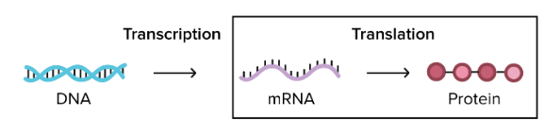
2. Translation
Basically, a gene is used to build a protein in a two-step process:
Step 1: transcription! Here, the DNA sequence of a gene is "rewritten" in the form of RNA. In eukaryotes like you and me, the RNA is processed (and often has a few bits snipped out of it) to make the final product, called a messenger RNA or mRNA.
Step 2: translation! In this stage, the mRNA is "decoded" to build a protein (or a chunk/subunit of a protein) that contains a specific series of amino acids.

Slide 50
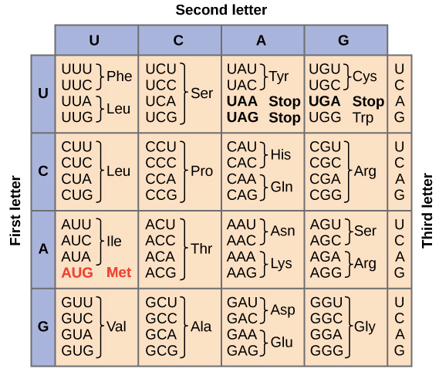
The genetic code
During translation, a cell “reads” the information in a messenger RNA (mRNA) and uses it to build a protein. Actually, to be a little more techical, an mRNA doesn’t always encode—provide instructions for—a whole protein. Instead, what we can confidently say is that it always encodes a polypeptide, or chain of amino acids.

Slide 51
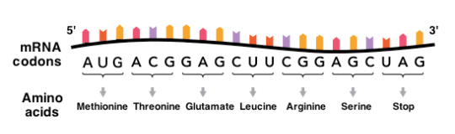
Genetic code reading
In an mRNA, the instructions for building a polypeptide are RNA nucleotides (As, Us, Cs, and Gs) read in groups of three. These groups of three are called codons.
There are 61 codons for amino acids, and each of them is "read" to specify a certain amino acid out of the 20 commonly found in proteins. One codon, AUG, specifies the amino acid methionine and also acts as a start codon to signal the start of protein construction.
There are three more codons that do not specify amino acids. These stop codons, UAA, UAG, and UGA, tell the cell when a polypeptide is complete. All together, this collection of codon-amino acid relationships is called the genetic code, because it lets cells “decode” an mRNA into a chain of amino acids.

Slide 52
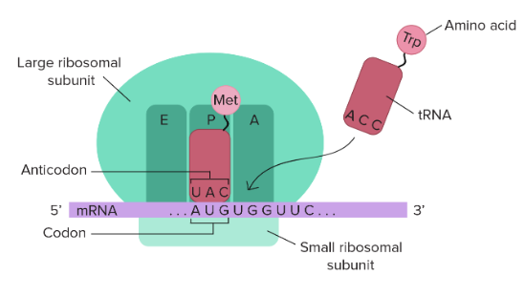
How is an mRNA "read" to make a polypeptide?
Two types of molecules with key roles in translation are tRNAs and ribosomes
Transfer RNAs (tRNAs)
Transfer RNAs, or tRNAs, are molecular "bridges" that connect mRNA codons to the amino acids they encode. One end of each tRNA has a sequence of three nucleotides called an anticodon, which can bind to specific mRNA codons. The other end of the tRNA carries the amino acid specified by the codons.
There are many different types of tRNAs. Each type reads one or a few codons and brings the right amino acid matching those codons.

Slide 53

Ribosomes
Ribosomes are the structures where polypeptides (proteins) are built. They are made up of protein and RNA (ribosomal RNA, or rRNA). Each ribosome has two subunits, a large one and a small one, which come together around an mRNA—kind of like the two halves of a hamburger bun coming together around the patty
The ribosome provides a set of handy slots where tRNAs can find their matching codons on the mRNA template and deliver their amino acids. These slots are called the A, P, and E sites. Not only that, but the ribosome also acts as an enzyme, catalyzing the chemical reaction that links amino acids together to make a chain.

Slide 54
Steps of translation overview
To see how cells make proteins, let's divide translation into three stages:
initiation (starting off),
elongation (adding on to the protein chain), and
termination (finishing up).
1 Getting started: Initiation
In initiation, the ribosome assembles around the mRNA to be read and the first tRNA (carrying the amino acid methionine, which matches the start codon, AUG). This setup, called the initiation complex, is needed in order for translation to get started.

Slide 55
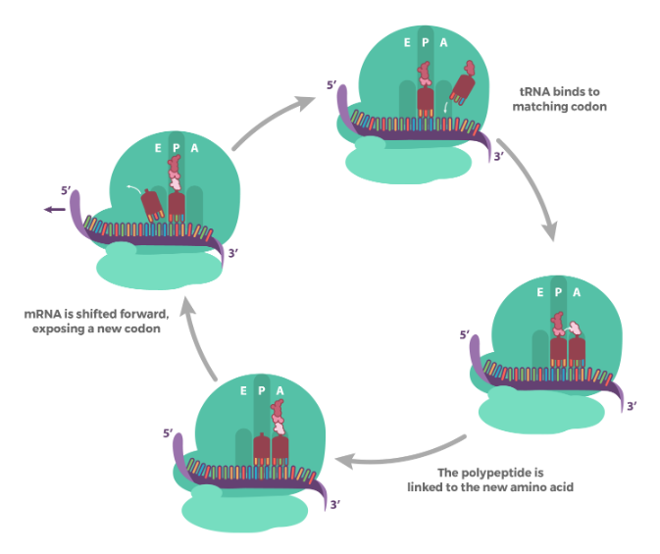
2. Extending the chain: Elongation
Elongation is the stage where the amino acid chain gets longer. In elongation, the mRNA is read one codon at a time, and the amino acid matching each codon is added to a growing protein chain.
Each time a new codon is exposed:
A matching tRNA binds to the codon
The existing amino acid chain (polypeptide) is linked onto the amino acid of the tRNA via a chemical reaction
The mRNA is shifted one codon over in the ribosome, exposing a new codon for reading
During elongation, tRNAs move through the A, P, and E sites of the ribosome, as shown above. This process repeats many times as new codons are read and new amino acids are added to the chain.

Slide 56
3. Finishing up: Termination
Termination is the stage in which the finished polypeptide chain is released. It begins when a stop codon (UAG, UAA, or UGA) enters the ribosome, triggering a series of events that separate the chain from its tRNA and allow it to drift out of the ribosome.
After termination, the polypeptide may still need to fold into the right 3D shape, undergo processing (such as the removal of amino acids), get shipped to the right place in the cell, or combine with other polypeptides before it can do its job as a functional protein.

Slide 57
Deep into Translation stages along with pro & Eukaryotes
In an mRNA, the instructions for building a polypeptide come in groups of three nucleotides called codons. Here are some key features of codons to keep in mind as we move forward:
There are 61 different codons for amino acids
Three “stop” codons mark the polypeptide as finished
One codon, AUG, is a “start” signal to kick off translation (it also specifies the amino acid methionine)
These relationships between mRNA codons and amino acids are known as the genetic code

Slide 58
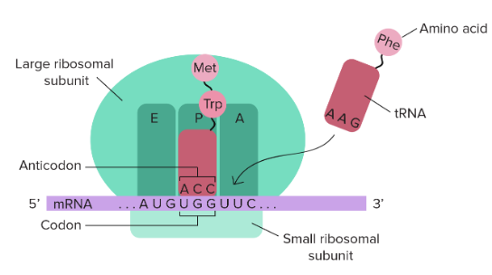
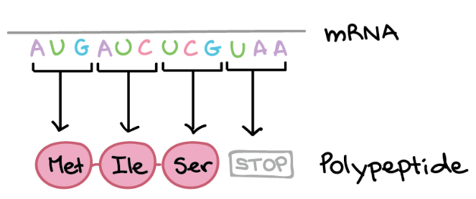
How Codons to amino acids?
In translation, the codons of an mRNA are read in order (from the 5' end to the 3' end) by molecules called transfer RNAs, or tRNAs.
Each tRNA has an anticodon, a set of three nucleotides that binds to a matching mRNA codon through base pairing. The other end of the tRNA carries the amino acid that's specified by the codon.
tRNAs bind to mRNAs inside of a protein-and-RNA structure called the ribosome. As tRNAs enter slots in the ribosome and bind to codons, their amino acids are linked to the growing polypeptide chain in a chemical reaction. The end result is a polypeptide whose amino acid sequence mirrors the sequence of codons in the mRNA.

Slide 59
1. Initiation
In order for translation to start, we need a few key ingredients. These include:
A ribosome (which comes in two pieces, large and small)
An mRNA with instructions for the protein we'll build
An "initiator" tRNA carrying the first amino acid in the protein, which is almost always methionine (Met)
During initiation, these pieces must come together in just the right way. Together, they form the initiation complex, the molecular setup needed to start making a new protein.

Slide 60
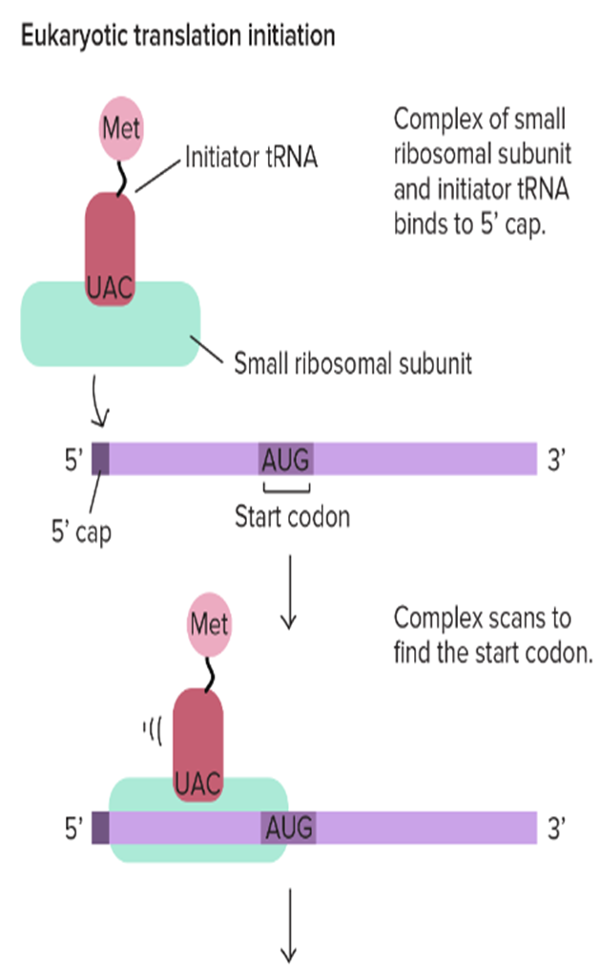
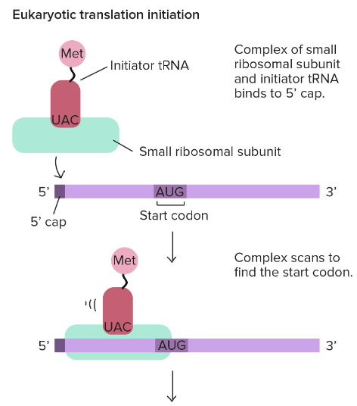
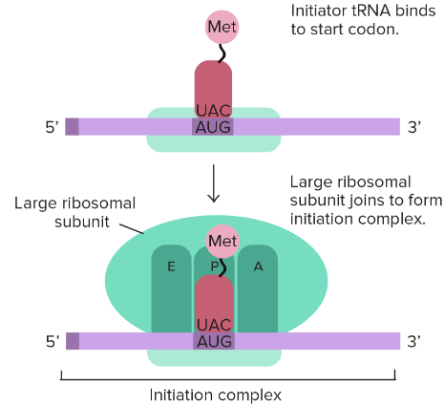
Cont.

Slide 61
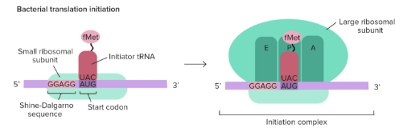
Prokaryotic Translation Initiation
In bacteria, the situation is a little different. Here, the small ribosomal subunit doesn't start at the 5' end of the mRNA and travel toward the 3' end. Instead, it attaches directly to certain sequences in the mRNA. These Shine-Dalgarno sequences come just before start codons and "point them out" to the ribosome.

Slide 62
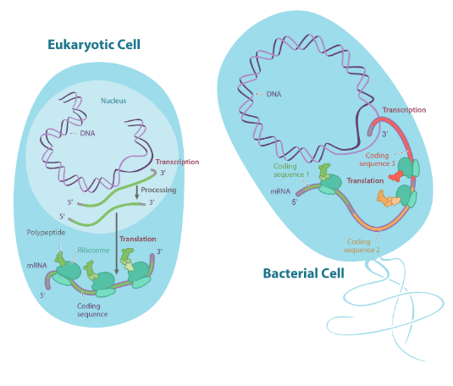
Why use Shine-Dalgarno sequences?
Bacterial genes are often transcribed in groups (called operons(Opens in a new window)), so one bacterial mRNA can contain the coding sequences for several genes. A Shine-Dalgarno sequence marks the start of each coding sequence, letting the ribosome find the right start codon for each gene.

Slide 63
2. Elongation
what happens in this "middle" stage of translation by its handy name: elongation is when the polypeptide chain gets longer.
But how does the chain actually grow? To find out, let's take a look at the first round of elongation—after the initiation complex has formed, but before any amino acids have been linked to make a chain
Our first, methionine-carrying tRNA starts out in the middle slot of the ribosome, called the P site. Next to it, a fresh codon is exposed in another slot, called the A site. The A site will be the "landing site" for the next tRNA, one whose anticodon is a perfect (complementary) match for the exposed codon.

Slide 64
How is the right tRNA chosen?
Non-matching tRNAs may also enter the A site. Why doesn't this cause wrong amino acids to be added to the chain?
Well, non-matching tRNAs may be able to enter the A site...but in general, they don't get to stay there. In a careful process that never fails to fascinate me, each tRNA is escorted by helper proteins, and only a tRNA that's a perfect match for the codon will be "released" into the A slot by its choosy helpers
A molecule of the energy storage molecule guanosine triphosphate (GTP) is used up to release the tRNA, which is why the diagram shows this step as needing GTP.

Slide 65
3. Termination
Polypeptides, like all good things, must eventually come to an end. Translation ends in a process called termination. Termination happens when a stop codon in the mRNA (UAA, UAG, or UGA) enters the A site.
Stop codons are recognized by proteins called release factors, which fit neatly into the P site (though they aren't tRNAs). Release factors mess with the enzyme that normally forms peptide bonds: they make it add a water molecule to the last amino acid of the chain. This reaction separates the chain from the tRNA, and the newly made protein is released.

Slide 66
Epilogue: Processing
Many proteins are good at folding on their own, but some need helpers ("chaperones") to keep them from sticking together incorrectly during the complex process of folding.
Some proteins also contain special amino acid sequences that direct them to certain parts of the cell. These sequences, often found close to the N- or C-terminus, can be thought of as the protein’s “train ticket” to its final destination. For more about how this works, see the article on protein targeting.

Slide 67
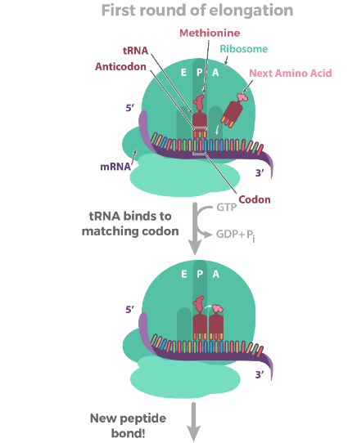
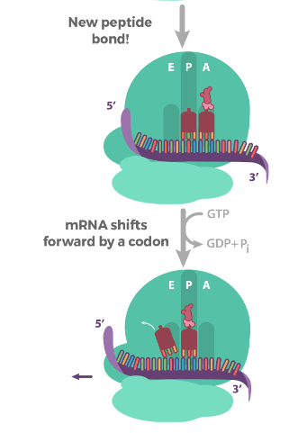
Once the matching tRNA has landed in the A site, it's time for the action: that is, the formation of the peptide bond that connects one amino acid another. This step transfers the methionine from the first tRNA onto the amino acid of the second tRNA in the A site. to

Slide 68
Post Translational Modification
Chemical modifications that take place at certain Amino acid after the protein is synthesised after translation are known as post-translational modifications
It is essential for the normal functioning of the proteins
They occur in ER & Golgi bodies of cell
An important function of Post translation is:
Increases in functional diversity of the proteomics
Generate heterogeneity in proteins
Carrier transport

Slide 69
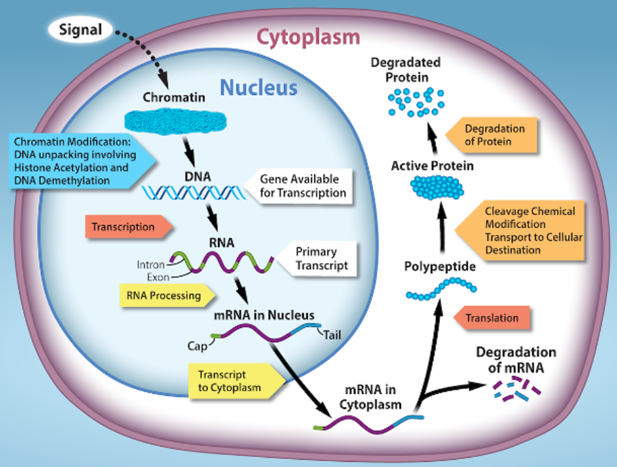
Prokaryotic versus Eukaryotic Gene Expression
Locations of gene regulation. The regulation of gene expression occurs at multiple steps going from DNA to the functional gene product, usually a protein. It begins with chromatin structure making the DNA more or less accessible for transcription by RNA polymerase.
In eukaryotes, the primary mRNA transcript must be processed before it can be translated in the cytoplasm. The final level of active protein in the cell depends not only on the rate of synthesis, but also on the rate of degradation of mRNA and protein.

Slide 70
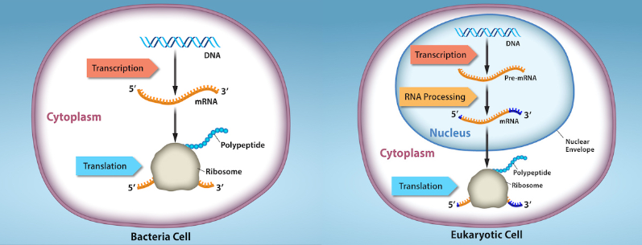
Regulation in prokaryotes and eukaryotes. A. Prokaryotic transcription and translation occur simultaneously in the cytoplasm, and regulation occurs primarily at the transcriptional level. B. Eukaryotic gene expression is regulated during transcription and RNA processing, which take place in the nucleus, and during protein translation, which takes place in the cytoplasm. Further regulation may occur through post-translational modifications of proteins in both prokaryotes and eukaryotes.

Slide 71
